Slide 1
Queue Management

Slide 2
Agenda
What is a Queue
Why Use Queues
How to create a queue.
How a queue manages the data it contains.
How to send data to a queue.
How to receive data from a queue.
What it means to block on a queue.
The effect of task priorities when writing to and reading from a queue
Next section
How to block on multiple queues.
How to overwrite data in a queue.
How to clear a queue.

Slide 3
What is a Queue
A queue in FreeRTOS is a data structure that allows one task to send data to another task.
It's essentially a buffer where one task can put data, and another task can take data out, often in a "first in, first out" (FIFO) order.
A queue can hold items of any data type, including primitive data types (int, float, etc.) or complex structures.

Slide 4
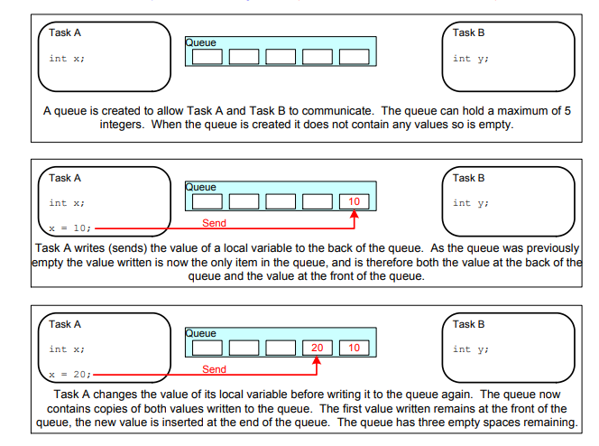
Why Use Queues?
Queues are useful for inter-task communication, allowing tasks to share data or pass messages.
They provide a mechanism for synchronizing tasks by allowing one task to block until data is available in the queue.
.

Slide 5
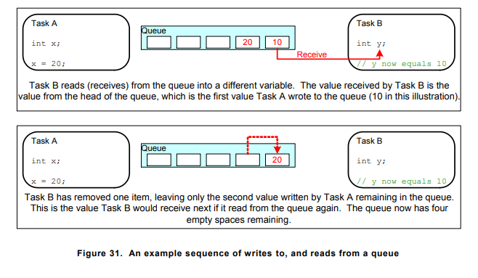

Slide 6
Access by Multiple Tasks
Blocking on Queue Reads
When a task attempts to read from a queue, it can optionally specify a ‘block’ time. This is the time the task will be kept in the Blocked state to wait for data to be available from the queue, should the queue already be empty. A task that is in the Blocked state, waiting for data to become available from a queue, is automatically moved to the Ready state when another task or interrupt places data into the queue. The task will also be moved automatically from the Blocked state to the Ready state if the specified block time expires before data becomes available.
Queues can have multiple readers, so it is possible for a single queue to have more than one task blocked on it waiting for data. When this is the case, only one task will be unblocked when data becomes available. The task that is unblocked will always be the highest priority task that is waiting for data. If the blocked tasks have equal priority, then the task that has been waiting for data the longest will be unblocked.
Notes:
Queues are objects in their own right that can be accessed by any task or ISR that knows of their existence. Any number of tasks can write to the same queue, and any number of tasks can read from the same queue

Slide 7
Access by Multiple Tasks
Blocking on Queue Writes Just as when reading from a queue, a task can optionally specify a block time when writing to a queue. In this case, the block time is the maximum time the task should be held in the Blocked state to wait for space to become available on the queue, should the queue already be full.
Queues can have multiple writers, so it is possible for a full queue to have more than one task blocked on it waiting to complete a send operation. When this is the case, only one task will be unblocked when space on the queue becomes available. The task that is unblocked will always be the highest priority task that is waiting for space. If the blocked tasks have equal priority, then the task that has been waiting for space the longest will be unblocked.

Slide 8
Example
As an example to queue management, first we saw two sender tasks and one receiver task. We created a queue with length of 5.
Sender tasks were running at priority 1 and the receiver task at priority 2.
The tasks that send to the queue do not specify a block time (sync. events), whereas the task that receives from the queue does.

Slide 9
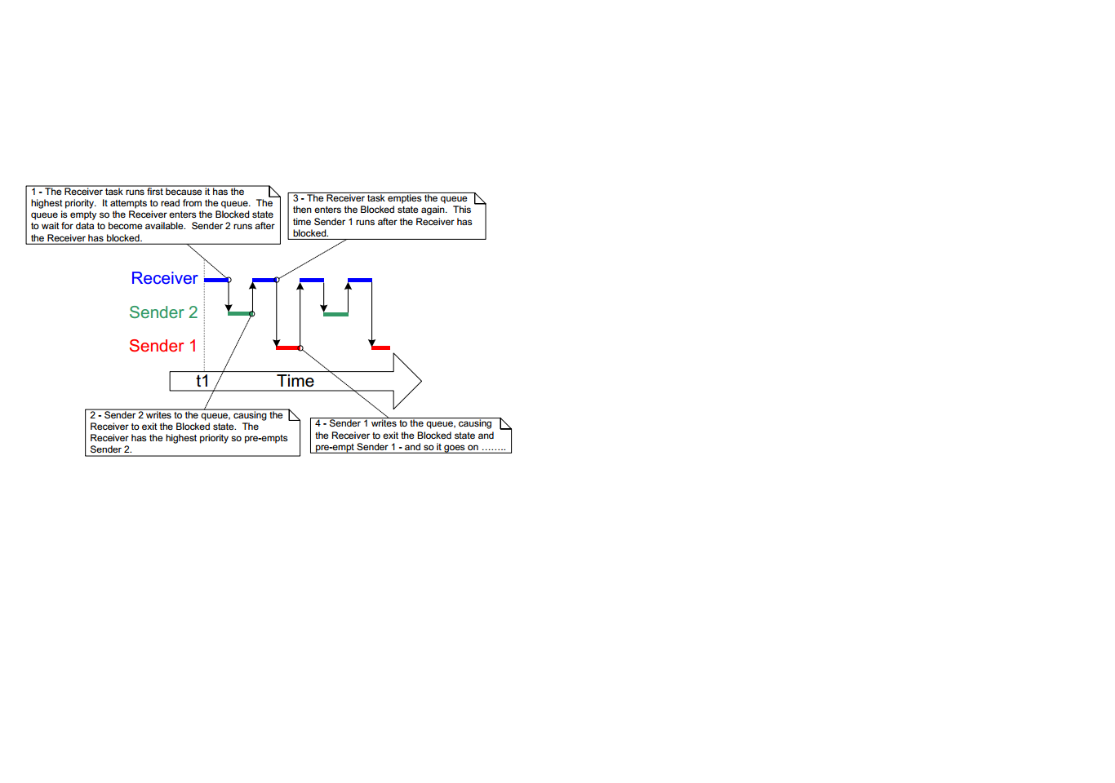

Slide 10
Queue APIs
QueueHandle_t xQueueCreate( uxQueueLength, uxItemSize ).
Parameter | description
uxQueueLength | The maximum number of items that the queue being created can hold at any one time.
uxItemSize | The size in bytes of each data item that can be stored in the queue.
Return Value | If NULL is returned, then the queue cannot be created because there is insufficient heap memory available for FreeRTOS to allocate the queue data structures and storage area. A non-NULL value being returned indicates that the queue has been created successfully. The returned value should be stored as the handle to the created queue.
Notes:
Queues are referenced by handles, which are variables of type QueueHandle_t. The xQueueCreate() API function creates a queue and returns a QueueHandle_t that references the queue it created.
QueueHandle_t xQueue;
xQueue = xQueueCreate(5, sizeof(int));

Slide 11
Queue APIs
xQueueSendToFront( QueueHandle_t xQueue,const void * pvItemToQueue,TickType_t xTicksToWait ).
BaseType_t xQueueSendToBack( xQueue, pvItemToQueue, xTicksToWait )
Parameter | Description
xQueue | The handle of the queue to which the data is being sent (written). The queue handle will have been returned from the call to xQueueCreate() used to create the queue.
pvItemToQueue | A pointer to the data to be copied into the queue.
xTicksToWait | The maximum amount of time the task should remain in the Blocked state to wait for space to become available on the queue, should the queue already be full
Notes:
Both xQueueSendToFront() and xQueueSendToBack() will return immediately if xTicksToWait is zero and the queue is already full. The block time is specified in tick periods, so the absolute time it represents is dependent on the tick frequency. The macro pdMS_TO_TICKS() can be used to convert a time specified in milliseconds into a time specified in ticks. Setting xTicksToWait to portMAX_DELAY will cause the task to wait indefinitely (without timing out), provided INCLUDE_vTaskSuspend is set to 1 in FreeRTOSConfig.h

Slide 12
Returned value There are two possible return values: 1. pdPASS pdPASS will be returned only if data was successfully sent to the queue.
2. errQUEUE_FULL errQUEUE_FULL will be returned if data could not be written to the queue because the queue was already full
Setting xTicksToWait to portMAX_DELAY will cause the task to wait indefinitely (without timing out),
Notes:
f a block time was specified (xTicksToWait was not zero) then the calling task will have been placed into the Blocked state to wait for another task or interrupt to make space in the queue, but the specified block time expired before that happened.
if (xQueueSend(xQueue, &dataToSend, 0) == pdPASS)
{}

Slide 13
Queue API
BaseType_t xQueueReceive( QueueHandle_t xQueue, void * const pvBuffer, TickType_t xTicksToWait );
Parameter | Description
pvBuffer | A pointer to the memory into which the received data will be copied.
Returned value | pdPASS pdPASS will be returned only if data was successfully read from the queue. errQUEUE_EMPTY errQUEUE_EMPTY will be returned if data cannot be read from the queue because the queue is already empty.

Slide 14
Queue APIs
xQueueReset(): Return the queue to its empty state UBaseType_t uxQueueMessagesWaiting( const QueueHandle_t xQueue )
uxQueueMessagesWaiting : Returns the number of items that are currently held in a queue.
Notes:
BaseType_t xQueueReset( QueueHandle_t xQueue );

Slide 15
Hands On
As descripted in the previous example

Slide 16
Hands on 2
We need an application that can:
Reads either max of numbers or typing Zero by buttons.
Calculates the average of these numbers, then
Displays it using Terminal.
Constrained to
At least two tasks(sender and receiver).
Using queue management.
Max. of numbers = 10.

